Slide 1
Events Planner
Daniel Kamins
@dkamins314 on GitHub

Slide 2
Description
EventsPlanner is a web application that allows a synagogue to set up, edit , customize and display their prayer schedule, events schedule and community notices.

Slide 3
Features
Secure Login
Create multiple schedules from dropdown lists
Add community notes to schedule

Slide 4
Planning-User Story
Users are able to login and create an account
Once users are logged in, they can:
Create new schedules /events with drop down options that cover
all Sabbaths, holidays, fasts and special date in the Jewish calendar
Add notes and special announcements applicable to the schedule/event
Customize community notes based on drop down life events
Display schedule/event to members

Slide 5
Planning - Database
Model classes/tables
Yearly Events - contains all the fields needed to create any schedule/event
Enums- contain the static information to provide comprehensive drop down lists for ease of use
All data is persistant and editable

Slide 6
Technology Stack
C#
Asp-Net Core
Identity
Html

Slide 7
Demo

Slide 8
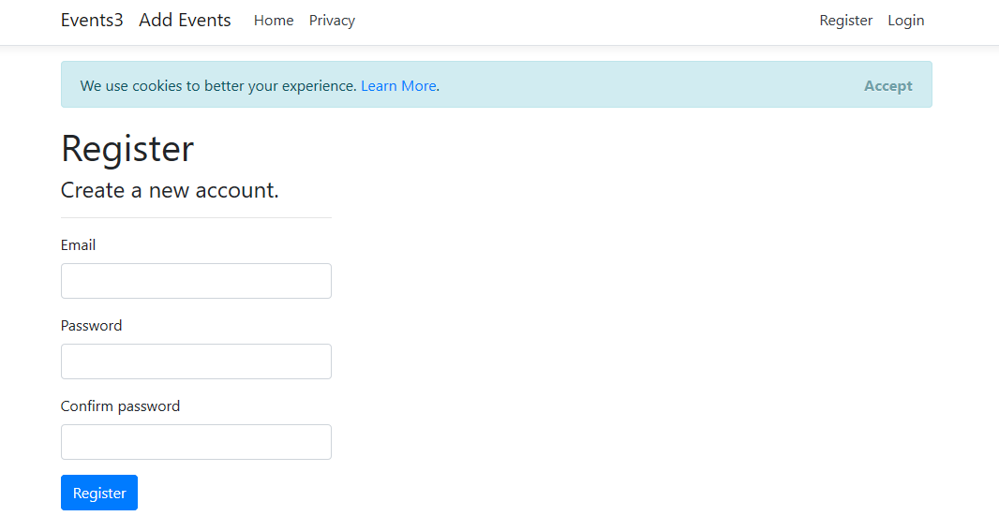
Register

Slide 9
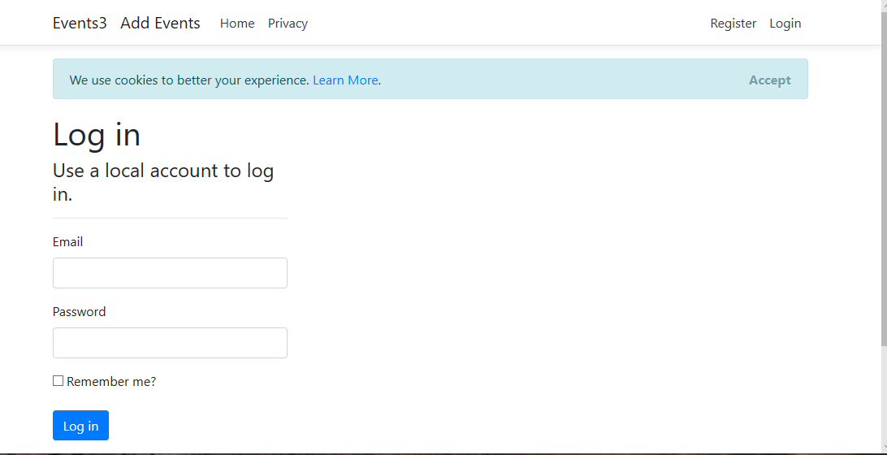
Login

Slide 10
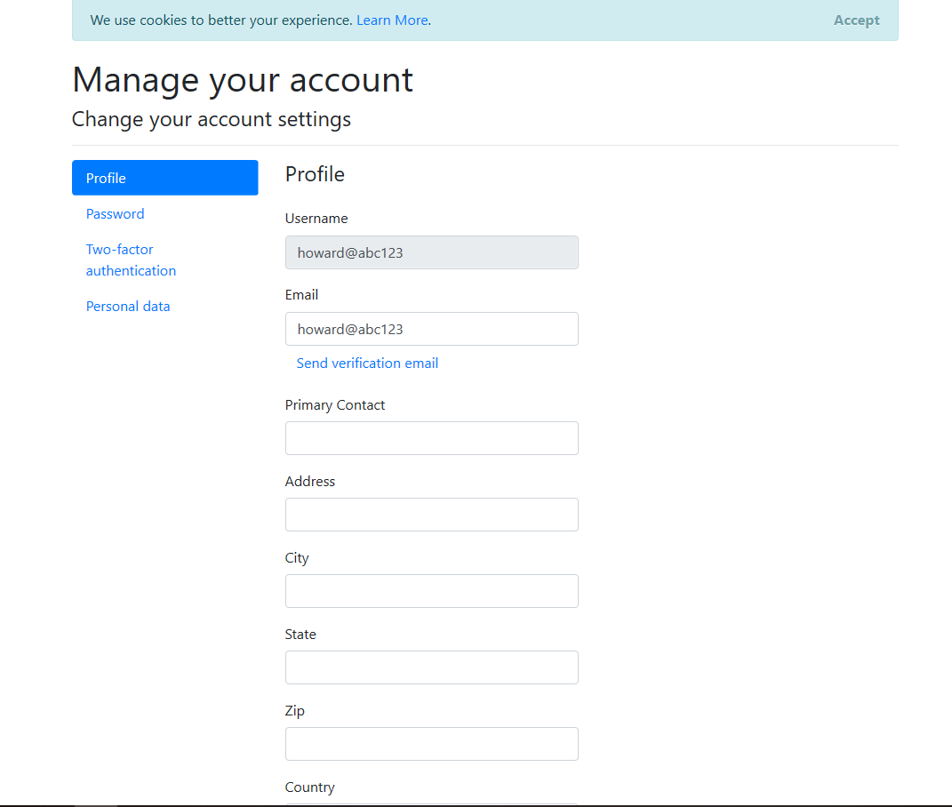
User Profile

Slide 11
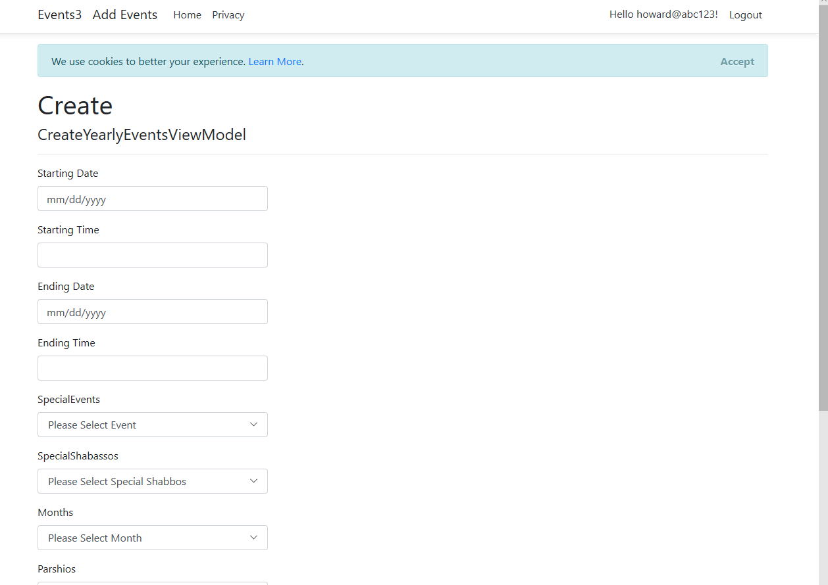
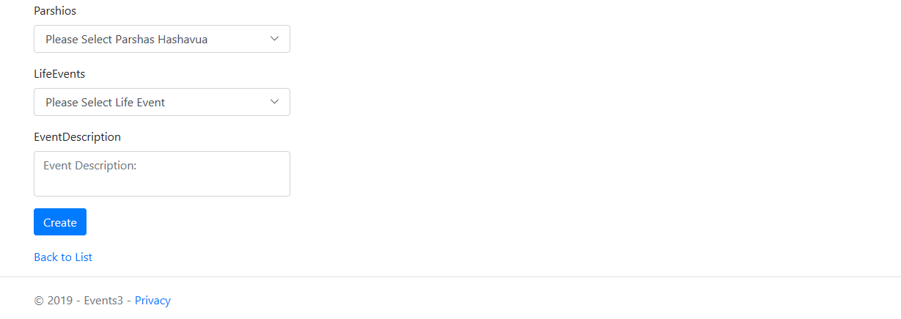
Create New Schedule

Slide 12
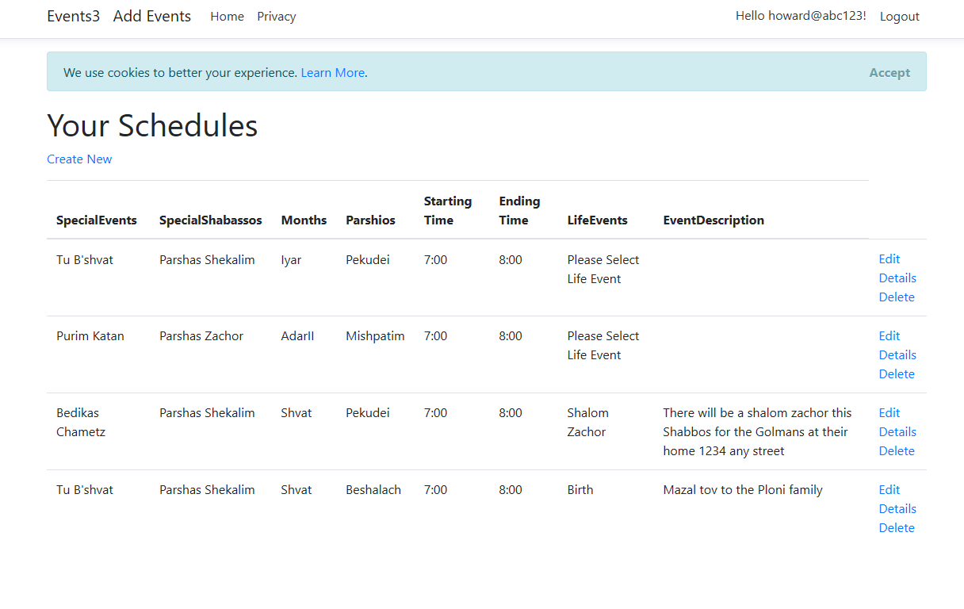
Schedule Display

Slide 13
What I learned
Working with and editing Identity
Recognizing changes in Asp-Net Core that makes older approaches incompatible
Working with Enum drop downs
Better knowledge of Git

Slide 14
What is next?
Adding users to make schedules available only to owner
Improving calendar display
Adding landing pages and secure buttons
Adding automated Halachic times

